Slide 1

Schizophrenia and
Alzheimer's Disease Psychosis Stakeholder Mapping
Final Feedback Meeting
July 2025

Slide 2
PRESENTATION CONTENTS
01
Project Introduction
An introduction to the project, discussing the objectives and key questions.
05
In-depth Profiles
Data summary of the KOLs that have in-depth profiles.
02
Desk Research
An overview of the parameters included within the mapping and the distribution of activity level.
06
Deliverables
Listing the deliverables that will be shared following the meeting.
03
Data Insights
Topline insights form the mapping, highlighting key statistical information.
07
Next Steps
Next steps for both Pi Healthcare & BMS.
04
Parameter Insights
Overviews for each of the mapped parameters from the data, showcasing key information.
08
Contacts
Contact details for Pi Healthcare if further information about the project is required.

Slide 3
Project Introduction

Slide 4


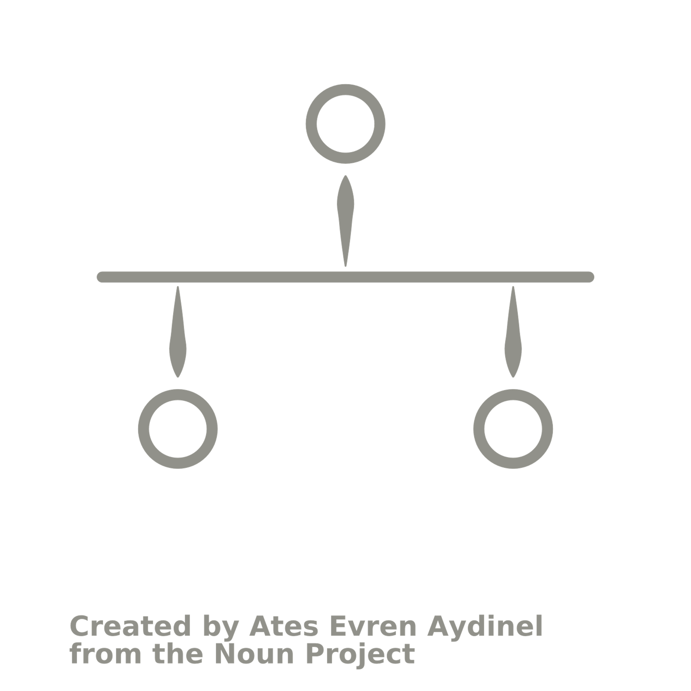

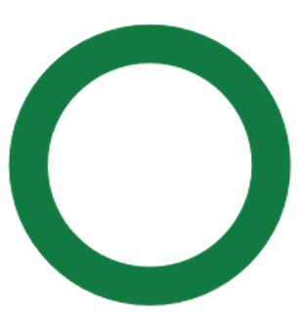
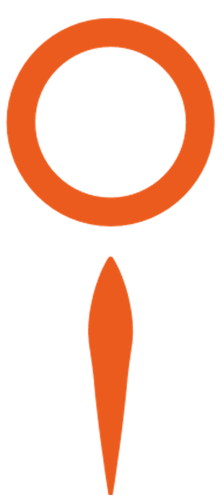
TIMELINE
Pi Healthcare initiated mapping including all desk research feedback.
September
Pi Healthcare created an additional 60 in-depth profiles & stakeholder dashboard.
June
Pi Healthcare created 50 in-depth profiles.
April
Final Feedback Meeting
July
2025
Kick-off Meeting
September
2024
Interim Meeting
December
2024
Continued support & collaboration
September
BMS reviewed the desk research and provide Pi Healthcare with their strategy.
November
Pi Healthcare collected & analyzed data, recommending 50 KOLs for in-depth profiles.
May
BMS provided delayed feedback for in-depth profile selection.
July
Pi Healthcare to host delayed rollout and Q&A meeting for the Power BI Stakeholder Dashboard
Delayed response from BMS in selecting their KOLs for in-depth profiles postponed the project.

Slide 5



PROJECT OBJECTIVES
Map
Monitor
Engage
Develop a structured global stakeholder overview with a drill down on 8 markets.
Identify a pool of 50 key experts (final 110).
Compile a list of Centers of Excellence & private clinics.
Upload all data to the stakeholder management dashboard.
Support the platform launch to ensure effective utilization by Bristol Myers Squibb teams.
Optimize access and engagement with key stakeholders.
Enable teams to leverage the platform to meet critical success factors in schizophrenia and Alzheimer’s disease psychosis.
Canada
France
Germany
Italy
Japan
Spain
UK
US

Slide 6





KEY QUESTIONS
Who are the key experts in schizophrenia and Alzheimer's disease psychosis?
What do these experts specialize in?
What are they publishing in?
Experts
Where are these stakeholders located?
Who is involved in regulatory/economic evaluation and guidance/pathways in the target countries?
Who has a voice in policy, market access & procurement?
Markets
Which professional organizations are working in schizophrenia and Alzheimer's disease psychosis?
Which patient organizations and advocacy groups are working in these disease areas?
Which experts engage with these organizations?
Advocacy
Which KOLs have a profile that match your objectives?
Who can you engage with?
Which KOLs can help direct corporate strategy with health equity?
Which KOLs are disseminating information on clinical/scientific content in alignment with your brands?
Strategy

Slide 7
Desk Research

Slide 8











PARAMETERS SEARCHED IN
Health EconomistTerms
Treatment Terms
Clinical Terms
Clinical Trials
Prof.
Orgs.
Patient
Orgs.
Regulatory Agencies
Payor Groups
Guidelines
Congresses
Journals
A total of 2,257 activities were uncovered across the 11 using the following MeSH search criteria.
Psychiatry
Specific
General
Neuropsychiatry/ Neuropsychiatric Syndromes/ Disorders/ Conditions/
Psychosis/
Psychotic Disorders/
Mental Disorders
Alzheimer's Disease/ AD/ Alzheimer's Disease Psychosis/ Psychosis in Alzheimer's Disease/ Dementia/ Psychosis in Dementia/ Schizophrenia/ Dementia Praecox/ Schizophrenic Disorders
Carer/ Care Giving / Geriatrics/ Gerontology/ Neurology/ Neuroscience/ Brain Disorder Psychiatry/ Mental Health/ Mental Illness/ Geriatric Psychiatry/ Psychology/ Psychotherapy/ Neuropsychology/ Psychogeriatrics

Slide 9
Specific
Alzheimer's Disease/ AD/ Alzheimer's Disease Psychosis/ Psychosis in Alzheimer's Disease/ Dementia/ Psychosis in Dementia/ Schizophrenia/ Dementia Praecox/ Schizophrenic Disorders
Psychiatry
General
53%
8%
39%
OF ACTIVITIES SEARCHED WERE DISEASE SPECIFIC
When analyzing disease-specific activities, schizophrenia showed a significantly higher presence compared to ADP, especially in Clinical Trials and Guidelines, where it dominated the available activities. In contrast, ADP-related content was slightly more visible than schizophrenia within Patient Organizations and Congresses.

Slide 10
2,257 ACTIVITIES WERE CAPTURED IN THE DESK RESEARCH
CLINICAL TRIALS
CONGRESSES
JOURNALS
PUBLICATIONS
PROFESSIONAL ORGANIZATIONS
PATIENT ORGANIZATIONS
GUIDELINES
REGULATORY AGENCIES
ADP & Alzheimer’s
Schizophrenia
PAYOR DRUG EVALUATION GROUPS
General & Psychiatry

Slide 11
Data Insights

Slide 12





KEY OPINION LEADERS
5%
OF STAKEHOLDERS ARE KEY OPINION LEADERS
3,818 stakeholders demonstrated significant engagement, earning the title of “Key Opinion Leaders”. We identified a total of 76,000 individuals during the research, reflecting varying activity levels.
Notes:
A total of 76,000 names were gathered during the research, reflecting varying activity levels. Among them, 3,818 demonstrated significant engagement, earning the title of “Key Opinion Leaders”.

Slide 13











PARAMETER INVOLVEMENT
Health EconomistTerms
Treatment Terms
Clinical Terms
Clinical Trials
Prof.
Orgs.
Patient
Orgs.
Regulatory Agencies
Payor Groups
Guidelines
Congresses
Journals
72%
69%
68%
41%
33%
15%
9%
7%
7%
2%
1%
Relative amount of KOL involvement within each parameter.
Notes:
KOLs constitute a larger proportion of all stakeholders identified in health economics, clinical trials, clinical terms, and treatment-related terms. In other areas, stakeholder names were recorded, but these instances were often isolated, preventing them from being classified as KOLs.

Slide 14




EQUALITY
36%
64%
FEMALE
MALE
Spain was the only country where there was no significant difference in scores between genders.
In all other markets of focus, males outperformed females based on mean scores.
Notes:
The Mann-Whitney U test revealed a significant difference in the overall scores between genders (W = 1,429,140, p-value = 6.095e-15), indicating that the distribution of the scores differs between males and females.

Slide 15





SPECIALTY
59%
Psychiatry
Of the 136 specialties identified, 2,267 identified as specialist psychiatrists.
24%
Other
Including Neurosciences (104) and Neurology (109).
15%
Psychology
Psychology was the named specialty of 588 KOLs.
2%
Nursing
Nursing was the named specialty of 80 KOLs.
Specialty had no overall impact on score.

Slide 16

MARKETS
31%
Canada
210
UK
308
OF KOLS ARE BASED IN THE USA.
Germany
320
France
175
USA
1,189
Statistically, KOLs in Canada, the United Kingdom, and Italy were more likely to outperform KOLs in the US, France and Japan. 69 countries outside the markets of focus were also captured.
Spain
136
Japan
453
Italy
230
Notes:
*Add statistics here

Slide 17


CITIES
The most highly KOL populated cities were London (108)
Tokyo (105)
New York (75)
Boston (61)
Toronto (60)
Barcelona (35)
Toronto
London
Boston
New York
Tokyo
Barcelona
Highest KOL Count (Top Cities)
Notes:
*Add statistics here

Slide 18
Parameter Insights

Slide 19




CLINICAL TERMS
33%
41%
82%
33%
87%
of KOLs had published using the term
“positive symptoms”.
Of KOLs had published using the term
“negative symptoms”.
of KOLs had published using the term “psychosis”.
of KOLs had published using the term “schizophrenia”.
Key Opinion Leaders
2,889 KOLs scored using clinical MeSH terms. 1,325 additional stakeholders were also captured.
Specialty
55% of KOLs publishing in “Psychosis” specialize in psychiatry.

Slide 20




TREATMENT TERMS
1%
1%
13%
68%
of KOLs had published using the term
“muscarinic antagonists”.
of KOLs had published using the term
“KarXT”.
of KOLs had published using the term
“mood stabilizers”.
of KOLs had published using the term
“anti-psychotic drugs”.
Key Opinion Leaders
2,498 KOLs scored using clinical MeSH terms. 962 additional stakeholders were also captured.
Specialty
82% of KOLs publishing in “KarXT” specialize in psychiatry.

Slide 21




HEALTH ECONOMIST TERMS
28%
36%
37%
45%
of KOLs had published using the term
“social functioning”.
of KOLs had published using the term
“adherence”.
of KOLs had published using the term
“PANSS”.
of KOLs had published using the term
“treatment outcomes”.
Key Opinion Leaders
2,655 KOLs scored using clinical MeSH terms. 1,252 additional stakeholders were also captured.
Specialty
67% of KOLs publishing in “treatment outcomes” specialize in psychiatry.

Slide 22


CLINICAL TRIALS
971 TRIALS
1,368 KOLS
311 PRINCIPAL INVESTIGATORS
12 KARXT TRIALS
Most of the trials identified were specifically in Schizophrenia with only 36 having an ADP focus.
A total of 4,085 stakeholders were identified.
135 PIs were in the USA. Spain had the lowest KOLs who had acted as PIs – with only 3.
Primarily include KOLs from the USA. 2 KOLs from Germany were also active in these trials.

Slide 23

CLINICAL TRIALS: KEY PEOPLE
Christoph Corell
Alkomiet Hasan
Peter Falkai
Stefan Leucht
Germany
Participated in the most clinical trials across the data (22) and has been PI for 8 of these.
Denmark
Participated in 21 trials and was PI in 3 of them.
Germany
Participated in 17 trials and was PI in 3 of them.
Germany
Participated in 14 trials and has not been a PI yet.
Number of Trials
Level of Influence
KOLs highest roles have been captured within the data.
PI Count

Slide 24


CONGRESS
International
27% of congresses included in the data were international.
KOL engagement at an international level was higher with 1,049 out of 2,283 engaging in some way.
Regional
17%
9% of Congresses included in the data were regional.
KOL engagement at a regional level was lower with 357 out of 2,283 engaging in some way.
National
64% of Congresses included in the data were national within one of the markets of focus.
KOL engagement was highest at a national level with 1,502 out of 2,283 engaging in some way.
Japan had the highest engagement across the dataset.

Slide 25
CONGRESS
Relevant congresses included in the research increased from 36 in 2020 to 98 in 2024. Stakeholder engagement increased in correlation with this.
2,282
KOLS HAVE BEEN INVOLVED IN CONGRESS.
Stakeholders
A total of 15,727 stakeholders have engaged with at least one of 360 congresses captured in the dataset.
KOLs
2024
Congress with the highest KOL engagement in 2024:
Annual Meeting of the Japanese Society of Psychiatry and Neurology (133 KOLs).
WPA World Congress of Psychiatry (132 KOLs)
Annual Meeting of American Psychiatric Association (104 KOLs)

Slide 26
JOURNALS
ROLES
Out of the 1,934 KOLs involved in journals, 35% held the role of Section Editor, 24% served as Editorial Board Members, and 27% were Associate Directors.
Stakeholders
SPECIALTIES
Out of the 63 unique specializations of KOLs identified, 38% of the KOLs contributing to journals specialized in Psychiatry, 8% in Psychology, and 7% in Clinical Psychology.
KOLs
MARKETS
Out of the markets of focus, America had the most KOLs contributing to journals, with 638 KOLs, followed by the UK with 197 KOLs, and Italy with 155 KOLs.
KOL Engagement per Journal Type

Slide 27
GUIDELINES
427
2019
was the year with the most KOL engagement in guidelines: 147 KOLs were engaged in national guidelines from the markets of focus.
2019
2022
KOLS HAVE ENGAGED WITHIN GUIDELINES
A total of 623 additional stakeholders have been captured.
2017
NATIONAL
2024
2004
1988
2013
INTERNATIONAL
2000
2015

Slide 28
KEY GUIDELINES
2000
2006
2017
2023
2024
1st International Schizophrenia Guideline
1st ADP Published Guideline
International Psychogeriatric Association
International Psychogeriatric Association
National Library of Medicine
In 2000 The American Journal of Psychiatry published the first International Guideline on Schizophrenia.
**UPDATED 2017
The earliest guideline addressing Alzheimer's disease psychosis, Behaviour Disorders of Dementia: Recognition and Treatment, was published in 2006.
The most recent ADP guideline, 'The IPA Complete Guides to Behavioural and Psychological Symptoms of Dementia,' was published in 2017.
The most recent ADP guideline, 'The IPA Complete Guides to Behavioural and Psychological Symptoms of Dementia,' was published in 2017.
The latest international schizophrenia guideline, 'Digital Mental Health for Schizophrenia and Other Severe Mental Illnesses,' was published in 2024

Slide 29




PATIENT ORGANIZATIONS
93 organizations were national organizations with only 4 and 4 international and regional organizations searched, respectively.
Location
Markets
98 KOLs were in North America, 515 from the EU and 3 from Japan.
213 KOLs have been captured within patient organizations alongside a further 3,040 stakeholders.
KOLs
The organizations with the highest KOL activity were The Centre for Addiction and Mental Health (Canada, 47) and Alzheimer’s Disease International (31).
Organizations

Slide 30
PROFESSIONAL ORGANIZATIONS
144 organizations were national organizations with only 39 and 24 international and regional organizations searched, respectively.
Location
Markets
631 KOLs were in North America, 515 from the EU and 328 from Japan.
1,818 KOLs have been captured within patient organizations alongside a further 17,713 stakeholders.
KOLs
The organizations with the highest KOL activity were World Federation of Societies of Biological Psychiatry (263) and The Japanese Society of Neuropsychopharmacology (122).
Organizations

Slide 31
PAYOR DRUG EVALUATION GROUPS
10
Groups per Market
From 4 groups and 606 stakeholders in Canada, 397 were involved with the National Institute of Excellence in Health and Social Services.
From 1 group in Japan, 29 stakeholders were involved with the Central Social Insurance Medical Council .
From 2 groups and 153 stakeholders in France, 93 were involved with the National Health Insurance Fund
From 2 groups and 182 stakeholders in Spain, 179 were involved with the Catalan Health Quality and Assessment Agency.
From 3 groups and 186 stakeholders in Germany, 116 were involved with the Institute for Quality and Efficiency in Health Care.
From 9 groups and 1,639 stakeholders in the United Kingdom, 1,408 were involved with the National Institute of Health Research.
From 2 groups and 4,013 stakeholders Internationally, 478 were involved with RTI International
From 10 groups and 919 stakeholders in the USA, 326were involved with the FDA.
From 2 groups and 67 stakeholders in Italy, 47 were involved with the National Agency for Regional Health Services.

Slide 32
REGULATORY AGENCIES
Agencies per Market
10
Within Canada the Mental Health Commission of Canada had the highest engagement from stakeholders with 44/195.
Within Japan the National Center of Neurology and Psychiatry had the highest engagement from stakeholders with 415/1,182.
Within France the National Agency for the Safety of Medicine and Health Products had the highest engagement from stakeholders with 475/975.
Within Spain the Spanish Agency of Medicines and Health Products had the highest engagement from stakeholders with 160/357.
Within Germany the Federal Ministry of Health had the highest engagement from stakeholders with 177/444.
Within the UK the NIHR - Health Technology Assessment had the highest engagement from stakeholders with 173/625.
2
Within Italy the Italy Ministry of Health had the highest engagement from stakeholders with 268/506.
Within the USA the National Institute on Aging had the highest engagement from stakeholders with 1,016/2,393.
Internationally, the Global Harmonization Working Party had the highest engagement from stakeholders with 422/7,959.

Slide 33
CENTERS OF EXCELLENCE
Stakeholders
1,541 stakeholders were captured across X CoEs. 135 of these were classified as KOLs.
King’s College London
Based in the UK, this CoE had the joint highest KOL involvement (18 KOLs) . 30% of CoEs were in the UK.
30%
17%
20%
Massachusetts's General Hospital
20% of CoEs were in the USA with Massachusett’s General Hospital
LMU Munich Hospital
Based in Germany, this CoE had the joint highest KOL involvement (18 KOLs). 17% of CoEs were in Germany.

Slide 34
PRIVATE CLINICS
Stakeholders
1,179 stakeholders were identified from 120 Private Clinics, with 31 classified as KOLs.
Skyland Trail
Based in the USA this PC had the highest KOL personel count with 37 different roles captured.
8%
31%
Priory
Based in the UK, 86 consultant names were captured for this PC.
Specialties
82 different specialties were captured within private clinics, including 90 nurses and 18 social workers.

Slide 35




HEALTH EQUITY
469 unique Roles Identified – 42% of KOLs list 'Professor' as their role.
36%
FEMALE KOLS
77
COUNTRIES
have 77,800 stakeholders.
11 Parameters searched.
136 specialties captured.

Slide 36


NOTABLE FINDINGS
Organizations
Specialties
Congress
While personnel details were extensive across the data, KOL engagement within patient and professional organizations appeared low. This may be due to the more general nature of these organizations as opposed to their specificity with schizophrenia and/or Alzheimer’s disease psychosis.
Psychiatry was the main specialty of KOLs.
KOLs tended to be concerned with psychosis as symptom of multiple diseases as opposed to specializing in one. Those who did specialize tended to do so within schizophrenia as opposed to Alzheimer’s disease.
Fewer regional congresses focusing on schizophrenia and Alzheimer’s disease psychosis were identified in the desk research. This was particularly evident in the USA, Canada, and Japan, where large national congresses appear to dominate. As a result, the data may suggest lower KOL involvement at the regional level.

Slide 37
In-depth Profiles

Slide 38


IN-DEPTH PROFILES
110 TOTAL
19% (21/110) of recommendations are female.
KOLs have been selected from 15 markets.
9 specialties.

Slide 39
Data Showcase
All Deliverables & Power BI Dashboard

Slide 40
Deliverables

Slide 41



FINAL DELIVERABLES
PowerPoint Slides highlighting the project methodology, desk research, KOL activities and notable findings.
Excel spreadsheets for the following data;
Desk Research Criteria, Full Dataset, In-Depth Profiles
Word CV for each of the in-depth profiles.
Interactive Power BI dashboard to enable and elevate KOL identification, monitoring and engagements.

Slide 42
Next Steps

Slide 43



NEXT STEPS
Review the in-depth profile deliverables.
Explore and utilize the Power BI dashboard
Review Deliverables
Schedule a follow-up Q&A meeting for the Power BI dashboard.
Schedule Meeting
The Power BI dashboard Q&A meeting.
Q&A Meeting

Slide 44





pi-healthcare.com
Need us?
Get in touch.
For more information on the contents of this document or our services.
jo@pi-healthcare.com
eddy@pi-healthcare.com
sharon@pi-healthcare.com
Find Us on LinkedIn

