Slide 1
Psoriasis
UK & Ireland
Stakeholder Mapping

Slide 2
Contents Page
Psoriasis Stakeholder Mapping Interim Slides
Content | Slide Number
Project Scope | 3
Data Collection Methodology | 6
Desk Research | 8
Highlighted KOLs | 16
Selecting Recommendations | 46
Deliverables | 53
Next Steps & Timeline | 55

Slide 3
Project Scope

Slide 4


Project Scope
Map Stakeholders
AND
Markets
Map Stakeholders and KOLs for Leo Pharma to help deliver the CSF’s
Raise awareness around psoriasis
Work with key stakeholders within relevant specialties to optimise access and engagement
Create a structured stakeholder overview for the Leo Pharma team for dissemination to marketing, regulatory, medical, market access & public affairs teams where appropriate
Cross pollinate and validate the stakeholder list with any relevant internal Leo Pharma data
Identifying a pool of 40 key experts across the countries of interest for the teams - to include clinical and important non-clinical experts
Upload data to the Digital Platform
The United Kingdom
Ireland

Slide 5
Your Requirements
INSIGHTS and EVIDENCE …. Which specialists (KOLs) have an interest within psoriasis and are shaping current and future developments?
Key questions to address include:
Who are the key influencers in the area?
Who are the main influencers (KOLs) by country & specialty?
Who publishes in key MeSH terms?
Which individuals/specialists offer the greatest investment potential?
Who is involved in regulatory/economic evaluation and guidance/pathways in the target countries?
Who has a voice in policy, market access & procurement?
Who are the relevant Professional/Advocacy groups and which KOLs are working with them?
Which KOLs are disseminating information on clinical/scientific content in alignment with Leo Pharma brands?
Which KOLs would be willing to engage with Leo Pharma for future projects related to your key platforms/topics?
Helps direct Corporate strategy with diversity and inclusion

Slide 6
Data Collection Methodology

Slide 7








Project Process
We help you achieve your objectives from stakeholder identification, to full engagement strategy
development and implementation.
Project Scope
Desk Research
Research Strategy
Analyse and review
In depth profiles
Digital upload
Discovery step, in which we work with you to understand the strategy & criteria for selection.
Our expert researchers analyse & search 100's of relevant data sources i.e. publications, clinical trials, associations, committees, journals, conferences etc.
We follow a tried & tested scoring criteria that meets your objectives & requirements which ensures that you get the best possible data results and recommendations.
We score, segment & evaluate stakeholders to create recommendations with short rationales. Collaborating we then select the mutually agreed-upon experts for additional profiling.
Each expert is researched independently, to identify publications, clinical trials, biographical info, organisation & editorial board membership, speaking engagements, industry engagement, grants etc.
The final deliverables will be uploaded onto a cloud-based, stakeholder platform.

Slide 8
Desk Research

Slide 9
What will the research provide?
Your requirements were for the following: clinical, societies, organisations, digital – we give you so much more.
Clinical
Other
Centres of Excellence
Societies and Organisations
Rising Stars
Dermatologists
Immunologists
Paediatricians
Clinical Psychologists
Clinical Pharmacists
GPwSIs
GPwER,
Specialist Nurses
Advanced Nurse Practitioners​
Health Boards
ICS
Parliamentary Groups
Regulatory
Market Access
Private Clinics
Dermatology Outreach Clinics
Community Dermatology Clinics
Hospital Dermatology COE
Payor & Drug Evaluation Groups
Patient & Professional Organisations
Up and coming KOLs

Slide 10









What do we search in?
We use extensive search parameters to produce detailed results. Here are just some of them:
Your data
Results
Journals
Celebrities
Influencers
MeSH Terms
Health Economic Publications
Guideline & Review Groups
MeSH Terms
Treatment Publications
Regulatory Authorities
Associations
MeSH Terms
Clinical Publications
Patient Groups
Relevant Conferences Over Past 5 years
Payor Groups
Clinical Trials

Slide 11
Activity Breakdown
Number of activities mapped within each parameter.

Slide 12
Desk Research Results

Slide 13


Stakeholders & Non-stakeholders
A Stakeholder is an individual who has scored frequently across the dataset or highly in one aspect of the dataset.​
All Stakeholders are listed on the Overview worksheet and have a PI_ID.​
A Non-Stakeholder refers to an individual meeting one of the following criteria:​​
Scored low in the dataset, such as being solely a member of a dermatology organisation.​​
Not relevant to the disease area but scored in one of the general parameters, such as holding a high position in a general journal.​
Non-Stakeholders are indicated as #N/A in the Excel spreadsheet.​

Slide 14
Key Opinion Leaders Results
In total we have identified 607 KOLs & 13,135 further individuals (non-KOLs).​
KOL and non-KOL captured in each section.
A KOL is classified as an individual who has activities in multiple parameters or scores highly in 1 relevant parameter.
A non-KOL is classified as an individual who only scores within one parameter or isn’t focused on the project disease (i.e. associate editor of a scientific journal).

Slide 15
KOL Breakdown
Geographical and specialty breakdown of KOLs identified.

Slide 16
Highlighted KOLs
Snapshot of the data and doesn't include all research parameters. For a full overview of the data and the KOLs active in these parameters please consult the excel document.
Chosen Research Parameters
Clinical Terms
Treatment Terms
Health Economists
Clinical Trials
Congresses
Guidelines
Patient Organisations

Slide 17
Recommendation Breakdown
The chart shows the percentage of recommended KOLs by country.​
England​ | 62%​
Ireland​ | 15%​
Scotland​ | 14%​
Wales​ | 8%​
Northen Ireland​ | 1%​

Slide 18
Professional Organisations

Slide 19
Professional Organisations
Region | Total | KOLs | Non-KOLs
International | 13 | 164 | 433
Regional | 9 | 19 | 123
National | 26 | 234 | 375
Total | 48 | 417 | 931
Name | Country | International | Regional | National
Christopher Ernest Maitland Griffiths | England | Y | Y | Y
Anthony Paul Bewley | England | N | Y | Y
Nicholas John Reynolds | England | N | Y | Y
Carsten Flohr | England | Y | Y | Y
Nicholas Julian Levell | England | N | N | Y

Slide 20

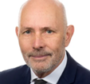
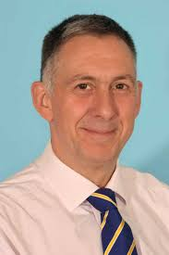
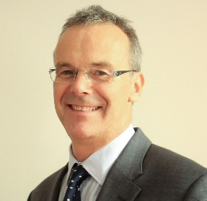
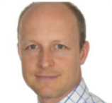



Top Scoring KOLs
Professional Organisations
Christopher Ernest Maitland Griffiths – Dermatology, England
Christopher Griffiths is the Director of the Manchester Centre for Dermatology Research and Head of the Dermatology Theme of the National Institute for Health Research (NIHR) Manchester Biomedical Research Centre. He Specialises in Psoriasis and Eczema.
He is Director of the PSORT (Psoriasis Stratification to Optimise Relevant Therapy) consortium.¹
He is involved in international and regional organisations including the Skin inflammation & Psoriasis International Network (SPIN)² and the European Society for Dermatological Research (ESDR).³
Anthony Paul Bewley – Dermatology, England
Dr Bewley is currently a Consultant Dermatologist at Whipps Cross and Barts. His research interests are psoriasis, eczema and acne.
He has multiple roles in European organisations. Such as President of the European Society for Dermatological Research (ESDR). He is on the steering committee of the British Association of Dermatologist and Biologic⁴ and Immunomodulators Register (BADBIR).⁵
Nicholas John Reynolds – Dermatology, England
Nick Reynolds is Professor of Dermatology at Newcastle University and Lead for the Personalised and Stratified Medicine theme within the NIHR Newcastle. He is also an honorary consultant dermatologist for the NHS. Since 2019, Nick has been a NIHR senior investigator. His clinical interests are focused on psoriasis and atopic eczema.
He is on the board of directors for the European Dermatology Forum⁶ and is on the steering committee of the British Association of Dermatologist and Biologic and Immunomodulators Register (BADBIR).⁷
Carsten Flohr – Dermatology, England
He is a Consultant Dermatologist at St John’s Institute of Dermatology, Guy’s and St Thomas’ NHS Foundation Trust and also Research and Development Lead at St John’s Institute of Dermatology.
He is on the Scientific Committee of the Skin Inflammation & Psoriasis International Network (SPIN)⁸ and a member of the steering committee for the European Dermato-Epidemiology Network.⁹
Nicholas Julian Levell – Dermatology, England
Nicholas Levell is a consultant dermatologist, GIRFT National Clinical Lead for Dermatology and Specialty National Lead for the Research Delivery Network. His research focus includes Atopic Eczema.
He is involved in multiple national professional organisations, including the British Association of Dermatologists (BAD)¹⁰ and the British Society of Medical Dermatology.¹¹
Recommended Back-up Recommendation

Slide 21
Congresses

Slide 22
Congress Activity
Number of KOLs identified within congresses.
This shows the number of KOLs that are active within congresses.​
As shown, there is greater activity within national congresses than international and regional combined.​
From the 447 KOLs within congresses 49 are active within national, regional and international congresses.

Slide 23
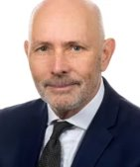
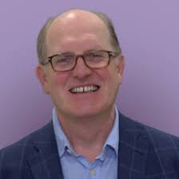
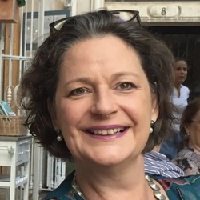
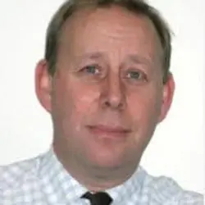
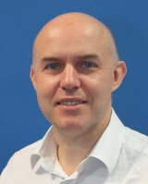
Top Scoring KOLs
International
Christopher Ernest Maitland Griffiths – Dermatology, England
Christopher Griffiths is the Director of the Manchester Centre for Dermatology Research and Head of the Dermatology Theme of the National Institute for Health Research (NIHR) Manchester Biomedical Research Centre. He is a Fellow of the Academy of Medical Sciences and an elected Member of Academia. He established the Manchester psoriasis Service in 1994. His leadership roles as past-President of several prominent organisations, including the British Association of Dermatologists, European Dermatology Forum, British Society for Investigative Dermatology, and International Psoriasis Council, further underscore his expertise. He was Co-Chair of the 2024 10th International Congress, Psoriasis: From Gene to Clinic.¹
Oliver FitzGerald – Rheumatology, Ireland
Oliver FitzGerald is a consultant rheumatologist and Newman Clinical Research Professor at St Vincent's University Hospital and the Conway Institute, University College Dublin (UCD), Ireland. His work is significant in rheumatology however he does co-author many publications on psoriasis including the Group for Research and Assessment of Psoriasis and Psoriatic Arthritis (GRAPPA): updated treatment recommendations for psoriatic arthritis (2021). In 2023 he was involved in an article on "differentiating patients with psoriasis from psoriatic arthritis using collagen biomarkers" and in 2022 he co-authored "Comparative Genetic Analysis of Psoriatic Arthritis and Psoriasis for the Discovery of Genetic Risk Factors and Risk Prediction Modelling". In 2021, he was Session Chair at the 6th World Psoriasis & Psoriatic Arthritis Conference.²
Lucinda Claire Fuller – Dermatology, England
Dr. Lucinda Claire Fuller has been working as a Consultant Dermatologist since 1997. She began her practice at London Bridge in 2000 and currently also works within the NHS at Chelsea and Westminster Hospital. Dr. Fuller has previously held consultant roles at King's College Hospital for 15 years and East Kent Hospitals. Her area of expertise is broad and includes rashes, skin cancers, cutaneous infections, and tropical dermatoses. In 2022, she was a part of the organising committee of the “3rd International League of Dermatological Societies (ILDS) World Skin Summit".³
Jonathan Nicholas William Noel Barker – Dermatology, England
Jonathan Barker is a professor of medical dermatology at St John's Institute of Dermatology. He was also the course director for the MSc in clinical dermatology until 2018. He created the severe psoriasis service at the St John's Institute, which is now the most holistic and comprehensive service in the UK, winning an award in 2016. He is the president of the International Psoriasis Council and sits on the Psoriasis Association Patients Organisation Medical Advisory Committee. He is also an editor of the Rook's Textbook of Dermatology, the leading English dermatology textbook. He was Co-Chair of the 2024 10th International Congress, Psoriasis: From Gene to Clinic.⁴
John Alexander McGrath – Dermatology, England
John McGrath is a Professor of Molecular Dermatology and Head of the Department at St John's Institute of Dermatology. He is also Head of the Genetic Skin Disease Unit and Honorary Consultant Dermatologist at the Guy’s and St Thomas’ NHS Foundation Trust in London. Previously, he was a Board Member of the European Society for Dermatological Research and was the Society’s President (2007-8). He was President of the European Dermatology Forum (2017-2019). John has published several papers on Psoriasis and was the lead for the UK National Institutes for Health Research on rare skin diseases. He was in the organising committee of the 2023 25th World Congress of Dermatology.⁵
Recommended Back-up Recommendation

Slide 24
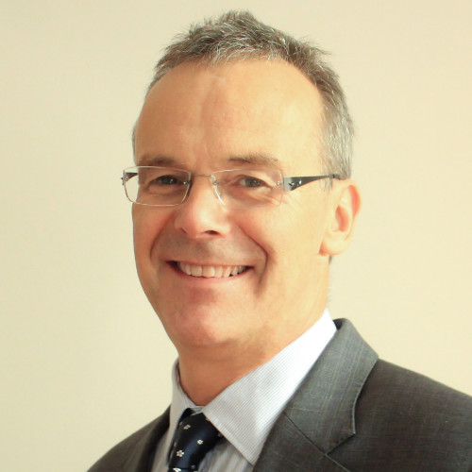
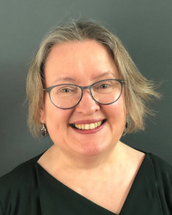
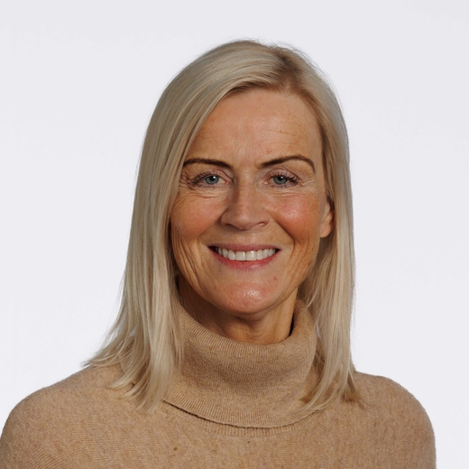
Top Scoring KOLs
Regional
Christopher Ernest Maitland Griffiths – Dermatology, England
Christopher Griffiths is the Director of the Manchester Centre for Dermatology Research and Head of the Dermatology Theme of the National Institute for Health Research (NIHR) Manchester Biomedical Research Centre. He is a Fellow of the Academy of Medical Sciences and an elected Member of Academia. He established the Manchester Psoriasis Service in 1994, demonstrating his dedication to this field. His leadership roles as past-President of several prominent organisations, including the British Association of Dermatologists, European Dermatology Forum, British Society for Investigative Dermatology, and International Psoriasis Council, further underscore his expertise. He was part of the organising committee of the 2023 26th Annual Meeting of the European Dermatology Forum (EDF).¹
Nicholas John Reynolds – Dermatology, England
Nick Reynolds is Professor of Dermatology at Newcastle University and Lead for the Personalised and Stratified Medicine theme within the NIHR Newcastle. He is also an honorary consultant dermatologist for the NHS. Since 2019, Nick has been a NIHR senior investigator. His current research and clinical interests are focused on psoriasis and atopic eczema, human models of skin disease, systems biology and precision medicine. He is also a member of the Executive Team for The Psoriasis Stratification to Optimise Relevant Therapy (PSORT) consortium – a unique partnership between five UK universities; 10 pharmaceutical and diagnostics companies; the Psoriasis Association and NHS partners representing patients. He was Session Chair at the “2024 27th Annual Meeting of the European Dermatology Forum (EDF)".²
Edel Ann O'Toole – Dermatology, England
She is a professor of Molecular Dermatology at the centre of Cell Biology and Cutaneous Research. She is a clinical academic with an active research group working on diverse aspects of keratinocyte biology related to rare skin diseases. She was the Chair of the British Society for Investigative Dermatology (2009-2011), on the ESDR board (2018-2022) and chaired the Diversity Taskforce. She was on the committee of the 51st Annual Virtual European Society for Dermatological Research (ESDR) Meeting (2022).³
Lucinda Claire Fuller – Dermatology, England
Dr. Lucinda Claire Fuller has been working as a Consultant Dermatologist since 1997. She began her practice at London Bridge in 2000 and currently also works within the NHS at Chelsea and Westminster Hospital. Dr. Fuller has previously held consultant roles at King's College Hospital for 15 years and East Kent Hospitals. Her area of expertise is broad and includes rashes, skin cancers, cutaneous infections, and tropical dermatoses. She was on the organising committee of the 2022 31st European Academy of Dermatology and Venereology (EADV) Congress.⁴
Sally Helen Ibbotson – Dermatology, Scotland
She is the Clinical Director of the Scottish Photodynamic Therapy Centre and is responsible for the photodynamic therapy (PDT) service for skin cancer in dermatology. She is R&D Co-Director of the Clinical Research Centre in Tayside, which undertakes the delivery of clinical trials across disciplines. She is Chair of the British Photodermatology Group and has a long-standing involvement in the development of UK and international guidelines in dermatology. She was involved in the 2023 32nd European Academy of Dermatology and Venereology (EADV) Congress.⁵
Recommended Back-up Recommendation

Slide 25
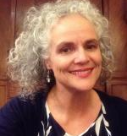

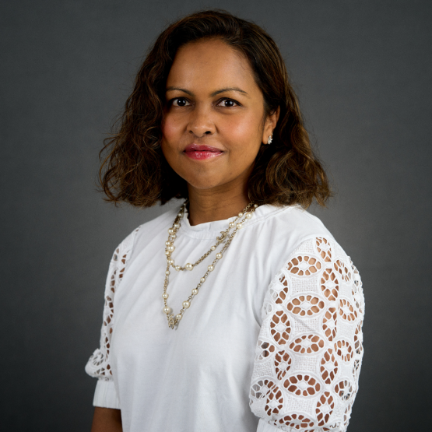
Top Scoring KOLs
National
Anthony Paul Bewley – Dermatology, England
Anthony Bewley is a Consultant Dermatologist at Barts Health NHS Trust and Honorary Professor at Queen Mary College (University of London). He is fully trained in general dermatology and has a special interest in psycho-dermatology (psycho-cutaneous medicine). Professor Bewley is a Clinical Advisor at the Psoriasis Association and was Chair of Psycho-dermatology UK 2008-20; President of the UK Dowling Dermatology Club 2019-20 and is currently Honorary Treasurer of the British Association of Dermatologists. He is President of the European Society for Dermatology and Psychiatry and runs training schools for healthcare professionals in psycho-dermatology. He was involved in the 2023 103rd Annual Meeting British Association of Dermatologists (BAD).¹
Catherine Anne Harwood – Dermatology, England
Catherine Harwood qualified in medicine from Cambridge University and St Thomas ' Hospital London in 1987. She trained in Dermatology as a registrar at St George's Hospital (1992-5). She then undertook research in the Centre for Cutaneous Research, Royal London Hospital , as a MRC Clinical Training Fellow (1995-8) and obtained a PhD on HPV and the molecular basis of non-melanoma skin cancer. After further SpR training at Barts and the London NHS Trust (1999-2001), she was appointed as a Clinical Senior Lecturer and Honorary Consultant Dermatologist to the Cancer Research-UK Skin Tumour Laboratory Clinical Programme. Catherine was promoted to Reader in Dermatology in October 2010. She was on the organizing committee of the 2023 103rd Annual Meeting British Association of Dermatologists (BAD).²
Christopher Ernest Maitland Griffiths – Dermatology, England
Christopher Griffiths is the Director of the Manchester Centre for Dermatology Research and Head of the Dermatology Theme of the National Institute for Health Research (NIHR) Manchester Biomedical Research Centre. He is a Fellow of the Academy of Medical Sciences and an elected Member of Academia. He established the Manchester Psoriasis Service in 1994, demonstrating his dedication to this field. His leadership roles as past-President of several prominent organisations, including the British Association of Dermatologists, European Dermatology Forum, British Society for Investigative Dermatology, and International Psoriasis Council, further underscore his expertise. He was on the organising committee of the 2022 102nd Annual Meeting of the British Association of Dermatologists (BAD).³
Mohammed Mahbub Ulhaque Chowdhury – Wales, Dermatology
Mohammed Chowdhury is a consultant dermatologist at the University Hospital of Wales in Cardiff, having been appointed as an Honorary Professor at Cardiff University in 2023, after receiving a National 3 Clinical Impact Award in 2022. His areas of interest include dermatitis and eczema. In July 2022, he was appointed CEO of the British Association of Dermatologists (BAD), succeeding his previous role as Chair for the Royal College of Physicians. He was on the committee of the 2023 103rd Annual Meeting British Association of Dermatologists (BAD).⁴
Rubeta Nishat Hashmi Matin – Dermatology, England
Dr Rubeta Matin is a UK-trained consultant dermatologist and honorary senior lecturer in Oxford since 2015. She is fully trained and on the GMC specialist register. She qualified from Guy’s, King’s and St Thomas’ Hospitals Medical Schools in 2001. She was on the organising committee of the 2022 102nd Annual Meeting British Association of Dermatologists (BAD).⁵
Recommended Back-up Recommendation

Slide 26
Publication score- Treatment Terms

Slide 27
Publications- Treatment Terms
Number of stakeholders publishing in selected treatment terms.

Slide 28
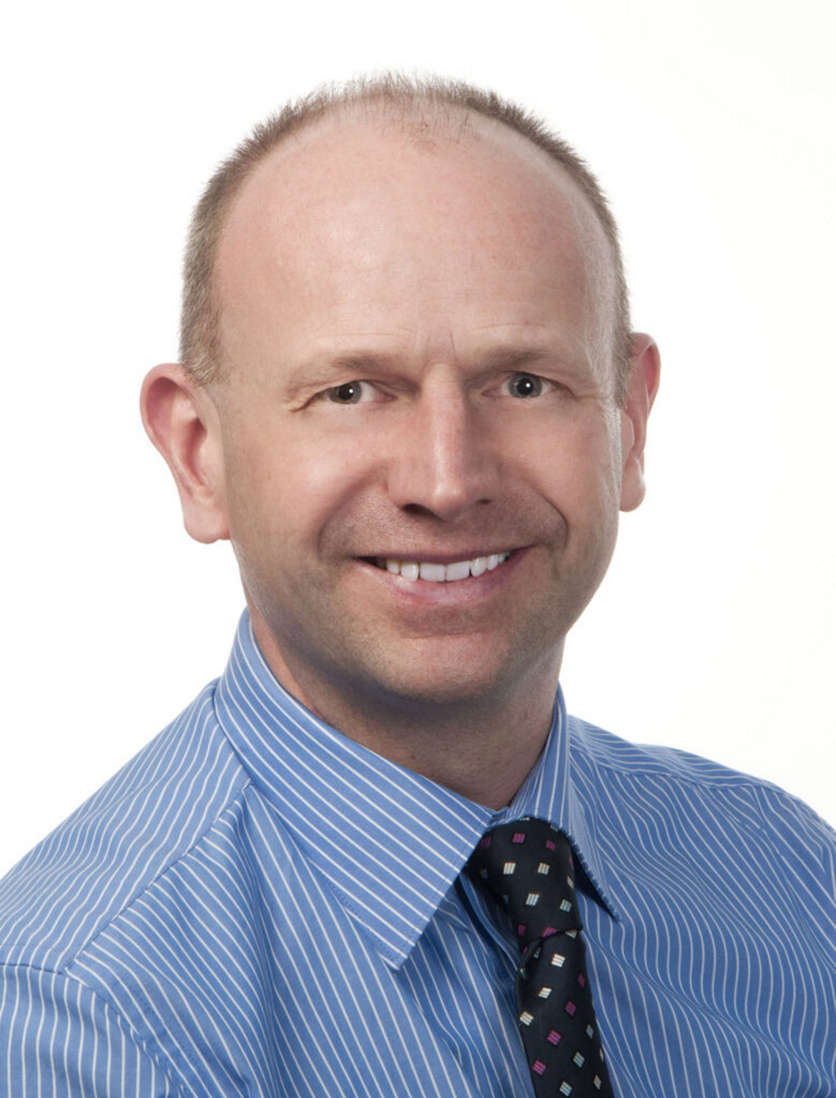
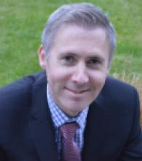
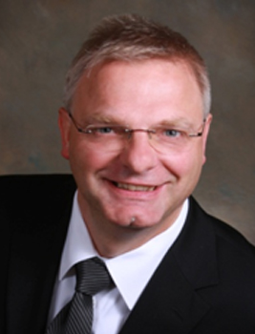
Top Scoring KOLs
Treatment Terms
Anthony Paul Bewley
Dermatology, England
Dr Bewley is currently a Consultant Dermatologist at Whipps Cross and Barts. His research interests are psoriasis, eczema and acne. He has published multiple times focusing on the effect of calcipotriol. Including “An anchored matching-adjusted indirect comparison of fixed-dose combination calcipotriol and betamethasone dipropionate (Cal/BDP) cream versus Cal/BDP foam for the treatment of psoriasis” (2022)¹ and “Calcipotriol and Betamethasone Dipropionate Cream Based on PAD Technology for the Treatment of Plaque Psoriasis: A Narrative Review” (2023).²
Richard Bruce Warren
Dermatology, England
He is a Professor of Dermatology and Therapeutics, and Honorary Consultant at the University of Manchester, having been awarded the J Hill Abram Prize for Medicine and the Reginald Dora Goodrick Prize for Surgery, as well as international awards from the British Association of Dermatologists and the American Academy of Dermatology.
He was principal researcher on “Four-Week Daily Calcipotriene / Betamethasone Dipropionate Foam Is Highly Efficacious in Patients With Psoriasis (PSO-LONG Lead-in Phase)” in 2021.³
Andrew Pink
Dermatology, England
He is a consultant dermatologist and the director of the adult clinical trials unit at St John's Institute of Dermatology, Guy's and St Thomas' NHS Foundation Trust. He is an honorary senior clinical lecturer at King's College London. He is a member of the International Psoriasis Council and Chair of the annual UK dermatology course for consultants. He regularly acts as a National Institute for Health and Care Excellence clinical expert.
He was involved in the publication of “Rapid onset of action of calcipotriol/betamethasone dipropionate cutaneous foam in psoriasis, even in patients with more severe disease” (2019).⁴
Christopher Ernest Maitland Griffiths
Dermatology, England
Christopher Griffiths is the Director of the Manchester Centre for Dermatology Research and Head of the Dermatology Theme of the National Institute for Health Research (NIHR) Manchester Biomedical Research Centre. He Specialises in psoriasis and Eczema. He has been involved in multiple publications on psoriasis. Including “Long-Term Proactive Treatment of Plaque Psoriasis with Calcipotriene/Betamethasone Dipropionate Foam Prolongs Remission and Reduces Relapses Irrespective of Patient Baseline Characteristics” (2021).⁵
Martin Steinhoff – Dermatology, Ireland
He is Professorial Chair and Director of the University College of Dublin. He is also Chairman of the Department of Dermatology and Venereology, as well as Director of the Interim Translational Research Center (iTRI).
He was involved in the publication of “lichen Planus: a comprehensive evidence-based analysis of medical treatment” (2019).⁶
Recommended Back-up Recommendation

Slide 29
Clinical Trials

Slide 30
Clinical Trials
The top scoring KOLs clinical trial activity count and their principal investigator count.

Slide 31
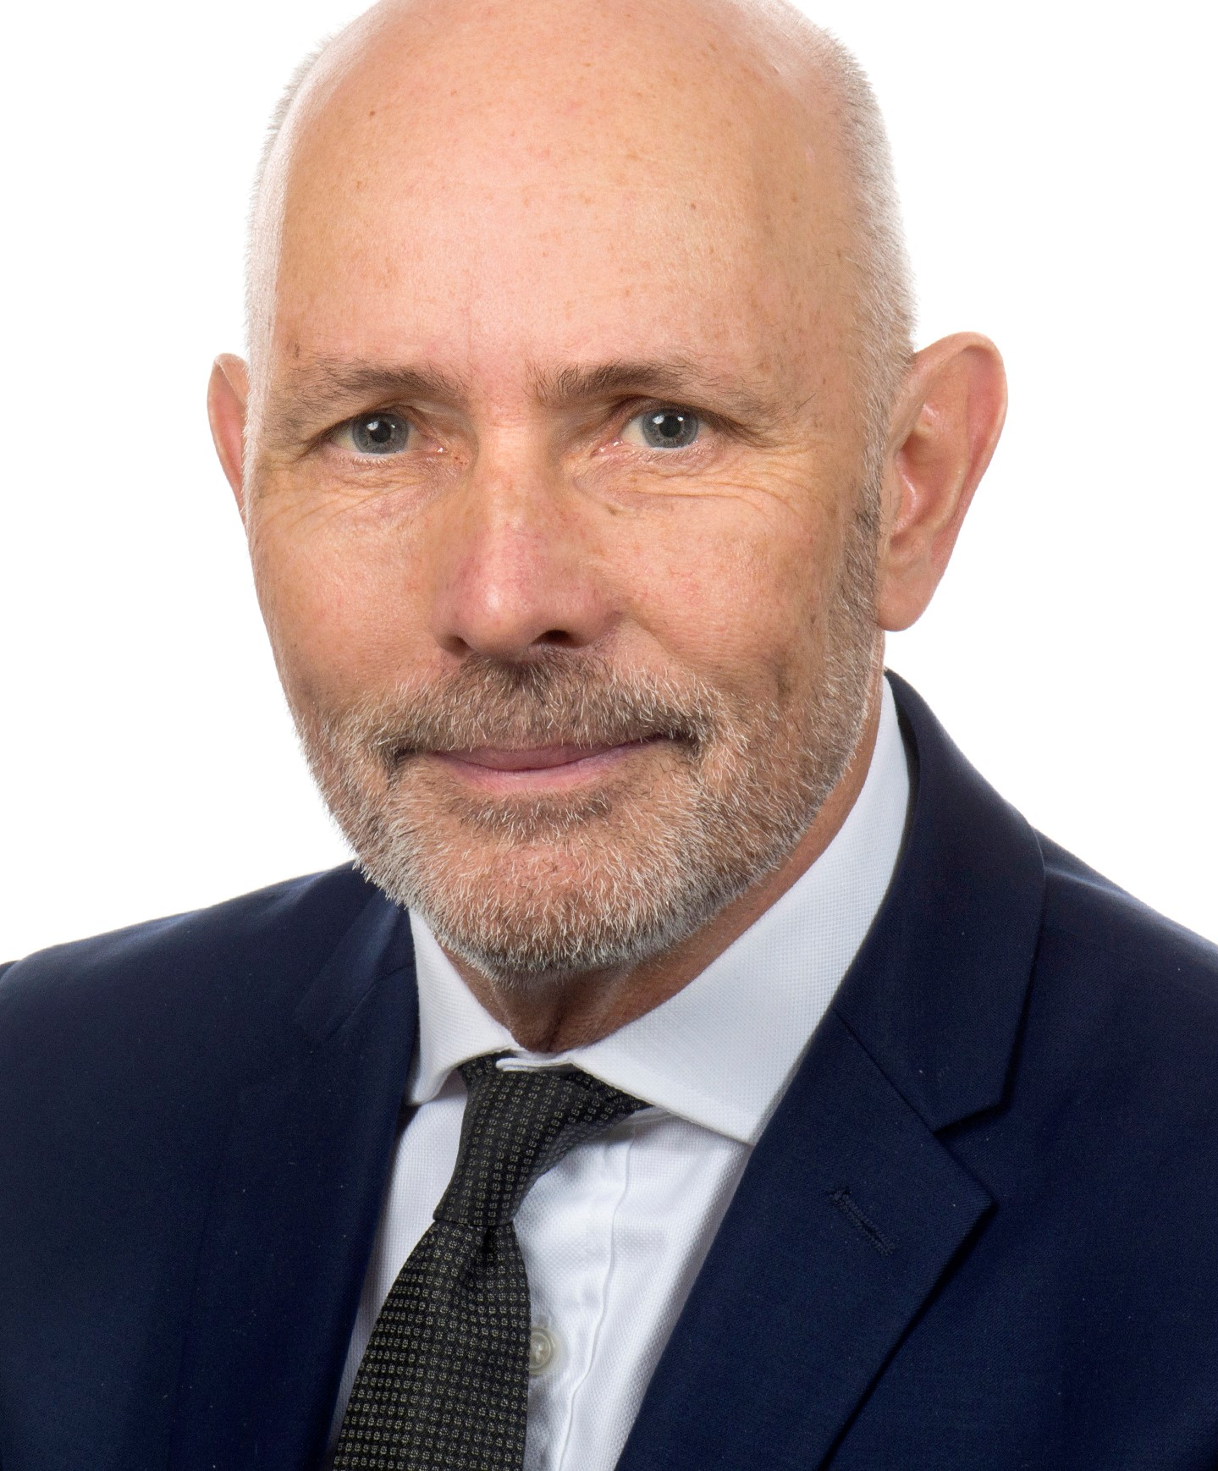
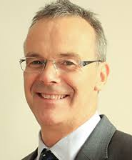
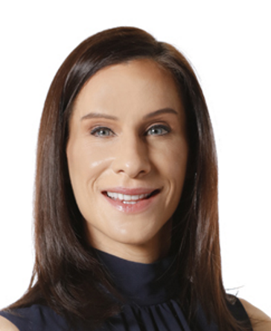
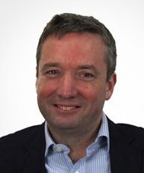
Top Scoring KOLs
Clinical Trials
Richard Bruce Warren – England, Dermatology
He is a Professor of Dermatology and Therapeutics and Honorary Consultant at the University of Manchester, having been awarded the J Hill Abram Prize for Medicine and the Reginald Dora Goodrick Prize for Surgery, as well as international awards from the British Association of Dermatologists and the American Academy of Dermatology. He has been principal investigator on SIGNATURE, the largest psoriasis treatment study running in the UK, as well as other clinical trials on drugs including secukinumab, risankizuma¹, brodalumab, ustekinumab², tildrakizumab³, bimekizumab, adalimumab⁴, certolizumab pegol⁵, and imsidolimab⁶ for psoriasis.
Christopher Ernest Maitland Griffiths – England, Dermatology
He is the Director of the Manchester Centre for Dermatology Research and Head of the Dermatology Theme of the National Institute for Health Research (NIHR) Manchester Biomedical Research Centre. He is the past president of the British Association of Dermatologists, European Dermatology Forum, British Society for Investigative Dermatology, and the International Psoriasis Council. He has large involvement in multiple clinical trials for psoriasis treatments, including Principal Investigator on a trial for long-term effectivity of guselkumab⁷. Notably, he is the only KOL to be involved in an Enstilar-specific trial, as the Principal Investigator on a trial demonstrating the foam to be more effective for psoriasis than gel-alternative⁸.
Arthur David Burden – Scotland, Dermatology
He is a Consultant Dermatologist and Professor of Dermatology at the University of Glasgow. He is on the International Psoriasis Council, and logistics lead for Psoriasis Stratification to Optimise Relevant Therapy. He has extensive involvement in psoriasis clinical trials, including as Principal investigator for a trial on the efficacy of spesolimab for treating generalized pustular psoriasis flares⁹.
Nicholas John Reynolds – England, Dermatology
He is Professor of Dermatology at Newcastle University and Lead for the Personalised and Stratified Medicine theme within the NIHR Newcastle. He is also an Honorary Consultant Dermatologist for the NHS, as well as an NIHR Senior investigator. He has past leadership positions of the UK Translational Research Network in Dermatology, the European Society for Dermatological Research, and the European Dermatology Forum. He has been chief investigator in 2 recent psoriasis clinical trials: A study exploring UVB phototherapy time of day on psoriasis¹⁰, and another investigating personalized UVB psoriasis treatment¹¹.
Caitriona Ryan – Ireland, Dermatology
She is a Consultant Dermatologist and Co-Founder at the Institute of Dermatologists and an Associate Clinical Professor at University College Dublin. She has a special interest in psoriasis education, publishing a textbook, book chapters, and research articles on psoriasis, and speaking at international dermatology conferences. She was the Chief Investigator in a 2021 clinical trial for Ixekizumab on effectivity against moderate-to-severe genital psoriasis (https://pubmed.ncbi.nlm.nih.gov/34812561/), and was also involved in a trial of risankizumab for moderate-to-severe plaque psoriasis (https://pubmed.ncbi.nlm.nih.gov/31280967/).
Recommended Back-up Recommendation

Slide 32
Publications – Clinical terms

Slide 33
Publications – Clinical terms
Number of stakeholders publishing in selected clinical terms.

Slide 34
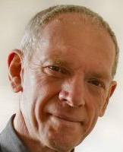
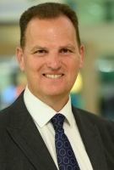
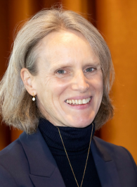
Top Scoring KOLs
Publications – Clinical MeSH terms
Richard Bruce Warren – England, Dermatology
Richard Bruce Warren is a professor of dermatology and therapeutics at The University of Manchester. He is co-lead of one of the two workstreams involved in Psoriasis Stratification to Optimise Relevant Therapies (PSORT). He is the Chief Investigator on the largest psoriasis study currently running in the UK, known as SIGNATURE, investigating a new biological therapy for the treatment of severe psoriasis.¹
Philip Stephen Helliwell – England, Rheumatology
Professor Philip Helliwell is an Associate Professor in Rheumatology at the University of Leeds, where he is responsible for clinical studies in psoriatic arthritis, and an Honorary Consultant Rheumatologist at Bradford Hospital. His main research interests are in the development of psoriatic arthritis in patients with psoriasis. In 2018, he contributed to the paper “Efficacy and safety of filgotinib, a selective Janus kinase 1 inhibitor, in patients with active psoriatic arthritis (EQUATOR): results from a randomised, placebo-controlled, phase 2 trial”.²
Iain Blair McInnes – Scotland,
Rheumatology
Professor Iain McInnes CBE is Vice Principal and Head of the College of Medical, Veterinary and Life Sciences, Muirhead Chair of Medicine and Versus Arthritis Professor of Rheumatology at the University of Glasgow. His research interests are in the biology of inflammatory synovitis in rheumatoid arthritis, psoriatic arthritis and septic arthritis.³
Christopher Ernest Maitland Griffiths – England, Dermatology
Chris Griffiths is Director of the Manchester Centre for Dermatology Research and Head of the Dermatology Theme of the National Institute for Health Research (NIHR) Manchester Biomedical Research Centre. He has contributed toward 359 publications on psoriasis with a research output of 698. In March 2024, he published “Characteristics of "Super-Responders" and "Super-Non-Responders" to First Biologic Monotherapy for Psoriasis: A Nested Case-control Study”.⁴ ⁵
Catherine Howard Smith – England, Dermatology
Catherine is an Adjunct Professor of Dermatology and Therapeutics and Consultant Dermatologist at St John’s Institute of Dermatology, Kings College London and Guys and St Thomas’ Hospital. She co-directs the Skin Therapy Research Unit and is also a lead clinician in national specialised services for adults with severe psoriasis and eczema. She chaired the UK's National Institute for Health and Care Excellence (NICE) guidelines on psoriasis and the British Association of Dermatologists guidelines on biologic therapy.⁶
Recommended Back-up Recommendation

Slide 35
Publications – Health Economist terms

Slide 36
Publications – Health Economist terms
Number of stakeholders publishing in selected health economist terms.

Slide 37

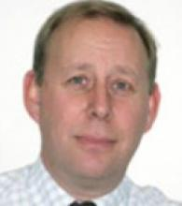
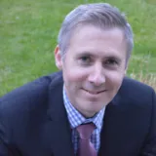
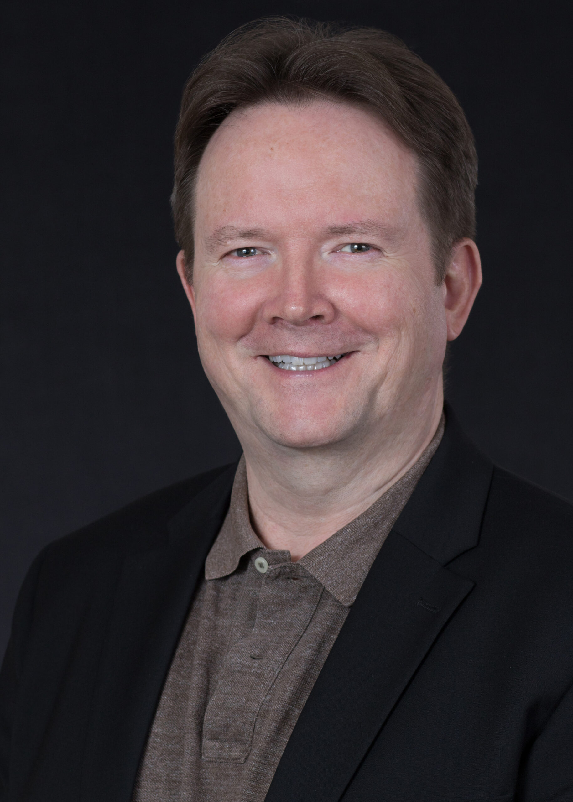
Top Scoring KOLs
Most relevant KOLs from Top 5 of each Health economist category.
Burden of Disease
Christopher Ernest Maitland Griffiths – England, Dermatology
Christopher Griffiths is the Director of the Manchester Centre for Dermatology Research and Head of the Dermatology Theme of the National Institute for Health Research (NIHR) Manchester Biomedical Research Centre. A multidimensional assessment of the burden of psoriasis: results from a multinational dermatologist and patient survey.¹
Burden of Disease
Jonathan Nicholas William Noel Barker – England, Dermatology
Jonathan Barker has been professor of medical dermatology at St John’s Institute of Dermatology since 2000 and was head of the Academic Department from 2002 - 2018 when he was also course director for master of science (MSc) clinical dermatology. He discusses the burden of psoriasis in his publication on" Biomarkers of disease progression in people with psoriasis: a scoping review.“²
Health related quality of life
Andrew Edward Pink – England, Dermatology
Andrew is a consultant dermatologist and the Director of the adult Clinical Trials Unit at St John’s Institute of Dermatology, Guy’s and St Thomas’ Hospitals, London. He produces a publication discussing the Health-related quality life of Entrial titled "Itch relief in patients with psoriasis: effectiveness of calcipotriol plus betamethasone dipropionate foam".³
Mental Health
Anthony Paul Bewley – England, Dermatology
Dr Bewley is currently a Consultant Dermatologist at Whipps Cross and Barts. He is an Honorary Senior Lecturer at Queen Mary Medical School, University of London. He discusses the pscyghology surrounding skin disease mentioning psoriasis within "An analysis of qualitative responses from a UK survey of the psychosocial wellbeing of people with skin conditions and their experiences of accessing psychological support.“⁴
Clinical Outcomes
Philip Gerard Conaghan – England, Rheumatology
He is Director of the NIHR Leeds Biomedical Research Centre; Prof of Musculoskeletal Medicine for UoL, Honorary Consultant Rheumatologist for LTHT; NIHR Senior Investigator Emeritus. He discusses clinical outcomes in several psoriatic arthritis publications such as "Long-term efficacy and safety of secukinumab in patients with psoriatic arthritis: 5-year (end-of-study) results from the phase 3 FUTURE 2 study.“⁵
Recommended Back-up Recommendation

Slide 38
Patient Organisations

Slide 39
Patient Organisations
Breakdown of the geographical location of the organisations mapped and the country of origin of KOLs and Non-KOLs identified within them.

Slide 40
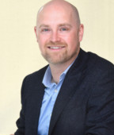

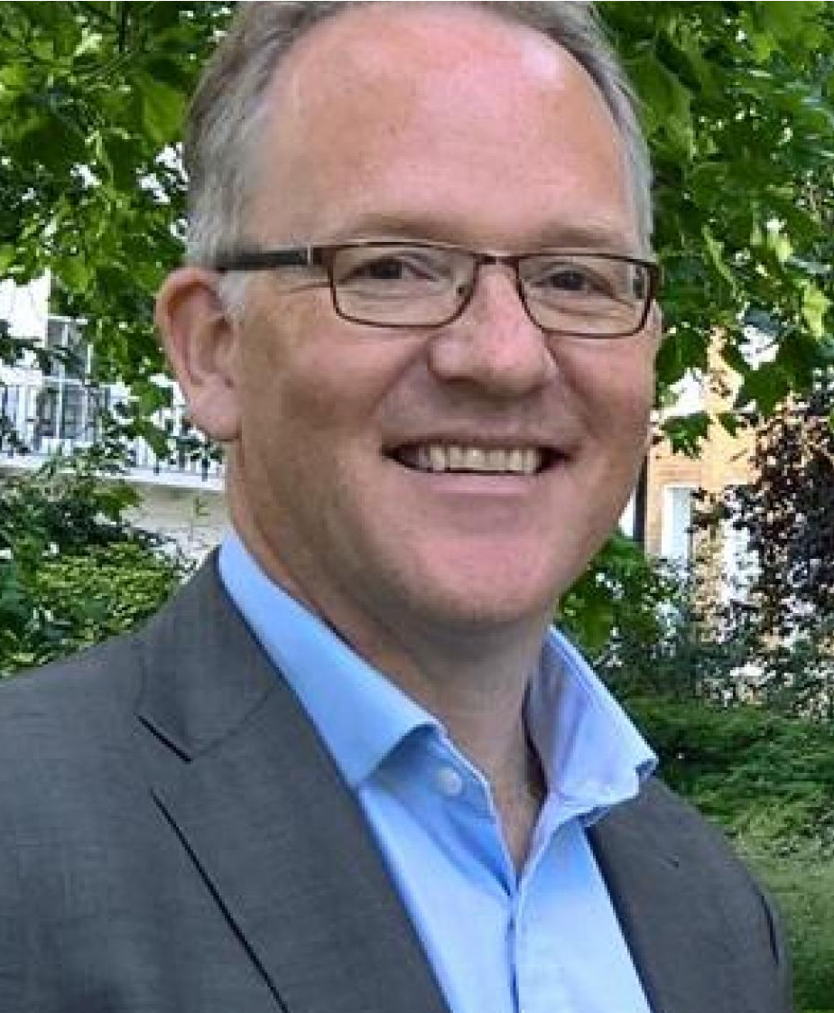
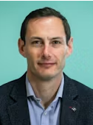
Top Scoring KOLs
Patient Organisations.
David McMahon – Ireland, Corporate Governance
David is the Chief Executive Officer of the Irish Skin Foundation and the Chair of the Executive Committee of the International Alliance of Dermatology Patient Organisations¹.
Catherine Howard Smith – England, Dermatology
Doctor Catherine Smith is a Professor of Dermatology and Therapeutics and a Consultant Dermatologist at St. John’s Institute of Dermatology, Kings College London and Guys and St. Thomas’ Hospital. She directs the Skin Therapy Research Unit and is a lead clinician in national specialised services for adults with severe psoriasis. She is a Board Member of the International Psoriasis Council.²
Christopher Ernest Maitland Griffiths – England, Dermatology
Chris is the Director of the MRC stratified medicine consortium on psoriasis (Psoriasis Stratification to Optimise Relevant Therapy; PSORT), the Director of the Global Psoriasis Atlas, and Chief Investigator of the BAD Biologics and Immunomodulators Register. He is an Honorary Founder of the International Psoriasis Council³.
Michael Roger Ardern-Jones – England, Dermatology
Micheal is an Associate Professor of Dermatology and Consultant Dermatologist at the University Hospital Southampton⁴. He is a member of the British Skin Foundation's Small Grants Advisory Committee. Michael Ardern-Jones previously served as President of the British Society for Medical Dermatology and Chair of the British Society for Investigative Dermatology. He also chairs The Skin Investigation Society.
Andrew R Thompson – Clinical Psychology, Wales
Dr Andrew Thompson is a Clinical Psychologist in Sheffield Health and Social Care NHS Foundation Trust. He is a Programme Director & Consultant Clinical Psychologist at the Cardiff & Vale University Health Board and Professor of Clinical Psychology at Cardiff University⁵. He's on the Board of Trustees of Changing Faces⁶ and a part of the Expert Advisory Group Panel of the Skin Support⁷ funded by British Association of Dermatologists (BAD).
Recommended Back-up Recommendation

Slide 41
Patient Organisations
Breakdown of the KOLs identified by region and the top KOLs who are active in multiple regions.
Region​ | Total​ | KOLs​ | Non-KOLs​
International​ | 44 | 17 | 27
Regional​ | 4​ | 1​ | 3
National​ | 272 | 49 | 223
Total​ | 315 | 67 | 253
Name​ | Country​ | International​ | Regional​ | National​
David McMahon | Ireland | Y​ | N​ | Y​
Catherine Howard Smith | England​ | Y​ | N​ | Y​
Christopher Ernest Maitland Griffiths | England​ | Y​ | N​ | Y​
Michael Roger Ardern-Jones | England​ | N | N​ | Y​
Andrew R Thompson | Wales​ | N | N​ | Y​

Slide 42
Guidelines

Slide 43
National, Regional and International Guidelines
Top scoring KOLs identified within guidelines.

Slide 44
National – England vs Scotland Guidelines
Breakdown of the top KOLs identified within national guidelines.

Slide 45
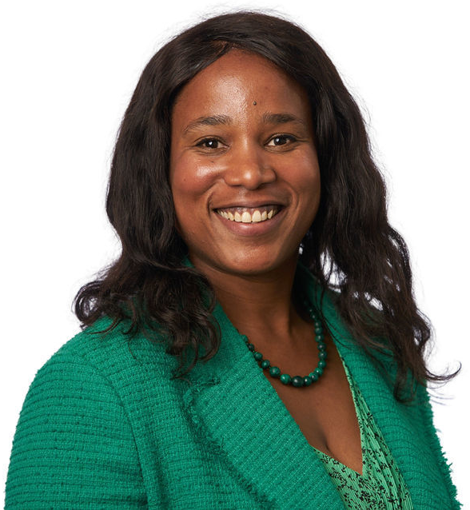
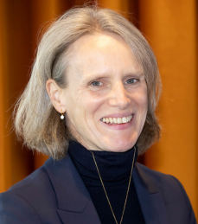
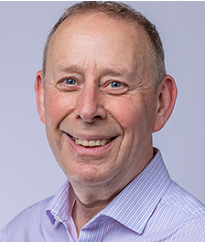
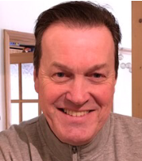
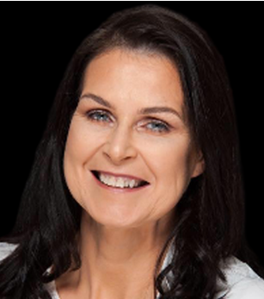
Top Scoring KOLs
Guidelines
Veline Sabrina L'Esperance England – General Practice
She is an academic GP and an NIHR doctoral fellow at Kings College London, in which she researches health economics. Veline is a NICE technology appraisal committee member (B) and has been involved with 12 plaque psoriasis drug guidelines. Including "Ixekizumab for treating moderate to severe plaque psoriasis" (2017) and more recently "Deucravacitinib for treating moderate to severe plaque psoriasis" (2023).
Catherine Howard Smith
England - Dermatology
Catherine is an adjunct professor of dermatology and therapeutics and consultant dermatologist at St John’s Institute of Dermatology, Kings College London and Guys and St Thomas’ Hospital. She co-directs the Skin Therapy Research Unit and is the lead clinician in national specialised services for adults with severe psoriasis. She was a specialist reviewer on the Scottish Intercollegiate Guidelines Network "Diagnosis and management of psoriasis and psoriatic arthritis in adults" guideline (2010) chair of the NICE "Management of psoriasis" clinical guidelines (2012). More recently she was clinical expert and co-authored guidelines by NICE and the British Association of Dermatologists on psoriasis treatment, for example "British Association of Dermatologists guidelines for biologic therapy for psoriasis 2020: a rapid update" (2020).
Jonathan Nicholas William Noel Barker
England – Dermatology
Jonathan is a professor of medical dermatology at St John's Institute of Dermatology, where he also creased the severe psoriasis. He co-authored national and international guidelines including the International Psoriasis Council "Recategorization of psoriasis severity: Delphi consensus" (2019) and the "Clinical use of dimethyl fumarate in moderate-to-severe plaque-type psoriasis: a European expert consensus" (2018). Nationally, he was on the clinical expert guideline committee of four NICE psoriasis treatment guidelines including "Ustekinumab for the treatment of adults with moderate to severe psoriasis" (updated 2017).
David Chandler
England - No Speciality
David is a psoriasis and psoriatic arthritis patient representative. He is the chief executive and co-founder of the Psoriasis and Psoriatic Arthritis Alliance. David is a patient expert and reviewer, in the UK and internationally. Including being a lay member for NICE, the Medicines and Healthcare products Regulatory Agency and the NIHR funding review panel. He is the patient expert on the NICE "Secukinumab for treating moderate to severe plaque psoriasis" (2015) guideline among others.
Pamela Margaret McHenry Northen Ireland - Dermatology
Pamela is consultant dermatologist practising in the Belfast Skin Clinic which she founded. In addition to her clinical work, Dr McHenry has published over 40 peer-reviewed publications. She is involved in NICE approved British Association of Dermatologist guidelines for dermatology therapy, including "guidelines for the safe and effective prescribing of oral ciclosporin in dermatology" (2018) and "guidelines for the safe and effective prescribing of methotrexate for skin disease" (2016).
Recommended Back-up Recommendation

Slide 46
Selecting Recommendations

Slide 47






Enstilar Executive Summary
Brand Vision | Capture the full value of the topical psoriasis portfolio by accelerating growth for Enstilar in order to remain the most prescribed topical cal/bd brand within psoriasis.
Brand Positioning | For patients diagnosed for the first time or dissatisfied with current treatment Enstilar is the unique spray foam That provides superior efficacy with a maintained safety profile when compared to TCS and other formulations of Cal/BD So that patients can get it right from the start and get on with their everyday life
Summary of Brand Performance
Core Learnings & Implications | Overall strong brand awareness and advocacy for Enstilar (76 / 135 formularies with Enstilar 1st/2nd line) Important prescribing factors for Psoriasis Treatment choice: Efficacy, Tolerability, Fast Onset of Action. Enstilar dominates Efficacy & Fast onset of Action HCPs predominance in UK for remote engagements. Project Connacht (digital only customer engagement) achieving ~10-12% growth. Existing blind spot- Source of Dynamic Business for Enstilar growth | Continue to drive efficacy, tolerability and fast onset of action messaging to support HCP view of increased future prescribing of Enstilar Safety differentiation vs. steroids for long term maintenance use. Extend digital reach of Connacht with e-consent capture Obtain data driven insights to drive future messaging content
Drivers & Barriers | Enstilar’s efficacy data and rapid visible results are key influential factors in prescribing decision of HCPs (new topical patients) Optimise the upgrade of Dovobet Gel & Ointment to Enstilar for better patient outcomes Extend reach of non segmented (non econsented) GP's due to NHS policy moving Dermatology services closer to the patient in primary care | GPs lack awareness and confidence to use Enstilar long term due to safety concerns (long term steroid use) NICE reserves Enstilar for later down the treatment pathway / more moderate and severe / switch patients Upgrade opportunity has potential to be lost due to generic competition
Brand Strategic Imperatives
Financials
SI1 Drive continued Enstilar growth through differentiation (on patient profiling and improving outcomes)
SI2 Protect Enstilar’s market leading position against competitor threats
SI3 Extend depth and breath of prescribing through expanding physician reach and impact

Slide 48
The 5 Step Process
Everyone
13,742
Crossover Analysis
Bios
66*
KOLs
607
Shortlist
68
01
Identify all active personnel.
02
Filter KOLs from Non-KOLs.
03
Create an initial shortlist of KOLs on highest scoring and specific MeSH terms.
04
Compare high-scoring KOLs to the individuals recommended in the CHE and AD mapping projects to ensure unique recommendations are included.
05
Create short biographies for selected KOLs.
*Includes back-ups and rising stars.

Slide 49

Creating a Shortlist
After completing steps 1 and 2, 63 amount of KOLs were identified. The following parameters were search to compile a shortlist.
Highest Scoring Stakeholders within International, Regional and National for the following:
Top scores within selected MeSH terms: (see notes for MeSH terms)
50
Top scorers from 5/33 terms were included in the shortlist.
109
69
97
18
Publications
Clinical Terms
Clinical Trials
Journals
Congresses
Patient Organisations
65
Top scorers from 5/106 terms were included in the shortlist.
28
18
30
48
Publications
Treatment Terms
44
Top scorers from 7/73 terms were included in the shortlist.
Regulatory
Payor
Guidelines
Professional
Organisations
Health Economist
Terms

Slide 50
Shortlist Results
Step 3
The initial shortlist using high scoring and publishing within specific MeSH terms provided 68 stakeholders, with the countries and specialties visualised in the charts.

Slide 51

Crossover Analysis
Step 4
Due to the large crossover of the top scoring KOLs between the 3 projects we lowered the recommendation level of some KOLs who received a CHE in-depth profile or who were recommended as part of the AD feedback.
Following this we conducted an additional search to highlight those KOLs with a focus on psoriasis that potentially scored lower in the data.

Slide 52
Recommendation Breakdown
Step 5
From the shortlist and further analysis, the recommendations, back-ups and rising stars were selected.

Slide 53
Thank you
Psoriasis Stakeholder Mapping – UK & Ireland

